Slide 1
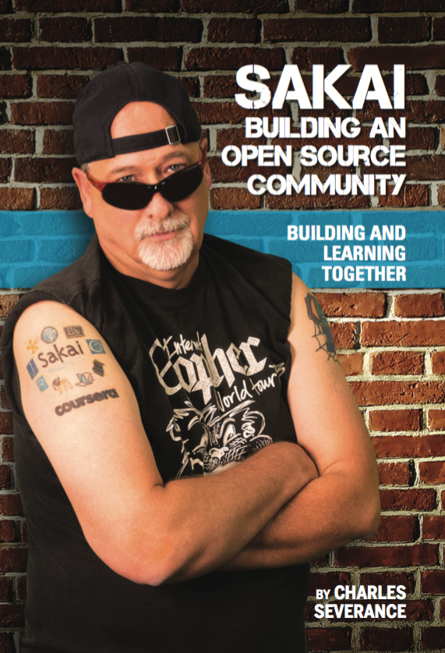
Sakai: Twenty Years of Innovation
Dr. Charles Severance
Sakai PMC Chair

Slide 2
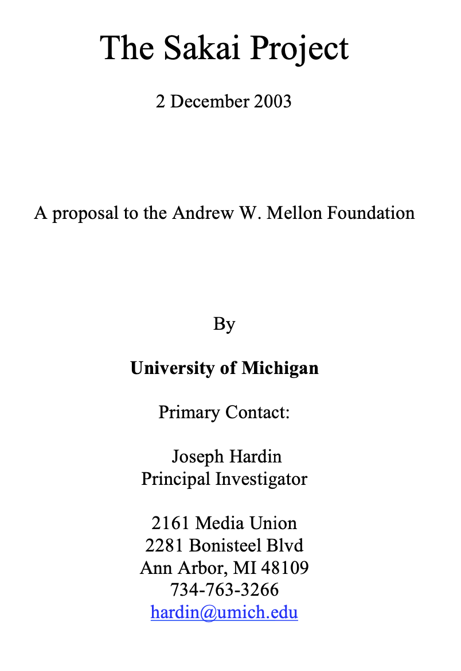
The products of this project will include an Enterprise Services-based Portal, a complete Course Management System with sophisticated assessment tools, a Research Support Collaboration System, a Workflow Engine, and a Tool Portability Profile, i.e., clear standard for writing future tools that can extend this core set of educational applications. ... This effort will demonstrate the compelling economics of “software code mobility” for higher education, and it will provide a clear roadmap for others to follow.

Slide 3
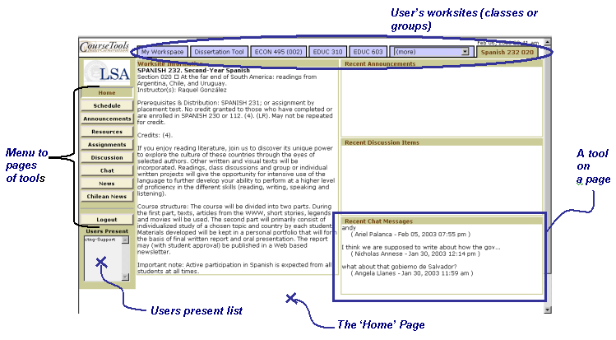

Slide 4
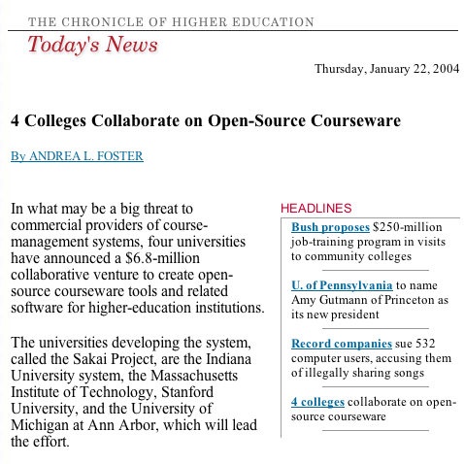

Slide 5
2004 Was a Blur…
Getting to know each other
Interest from around the world – lots of travel / recruitment
Where is the grade book?
Can you impersonate a user?
Is there any way to organize content other than files (like modules)?
JSF? Velocity? Hibernate? Spring?

Slide 6
At the end of 2004
We had our first IMS Tools Interoperability demo scheduled
University of Lleida ran Sakai 1.0 in production Fall 2004
All we knew was that we needed a version 2.0 quickly
Jetspeed -> Our own portal and augmented servlet
We needed to improve our use of a database
And we needed to build new core features all the while
Building Sakai 2.0 in six months in 2005 was the most productive effort I have ever been part of

Slide 7
The first half of 2005..
Sakai 2.0 was released in June 2005 just in time for our Baltimore Conference
It was an amazing rewrite – long hours and tough choices
The Summer 2005 conference was *packed* - tons of interest
Sakai was growing – it "looked" exponential at the time ☺

Slide 8
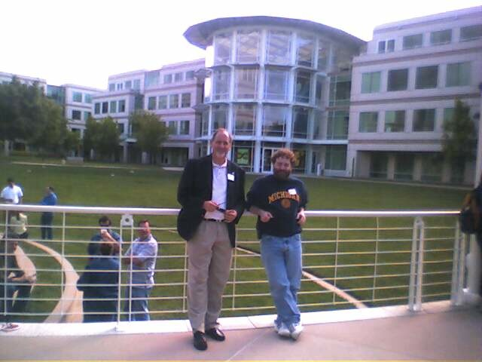
April 27, 2005

Slide 9
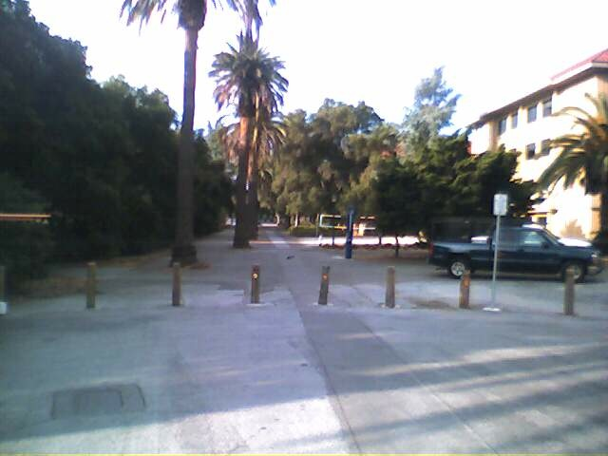
April 29, 2005 – Common Cartridge Launch

Slide 10
Common Cartridge
Meeting – Stanford April 27, 2005
Publishers + Sakai Board
Idea: Sakai would make an interchange standard, publishers would adopt it, and force it on the other LMS vendors
I suggested we do it through IMS (now 1EdTech) because we were so busy in our Sakai 2.0 rewrite and I did not want to become a standards organization
We would roll the CC idea out June 2005

Slide 11
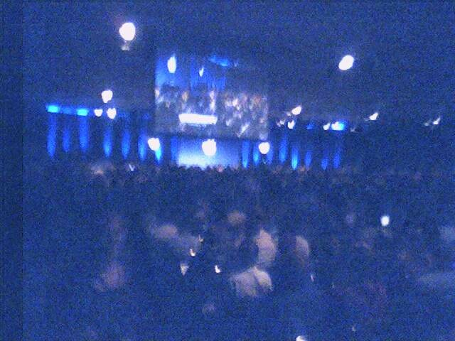
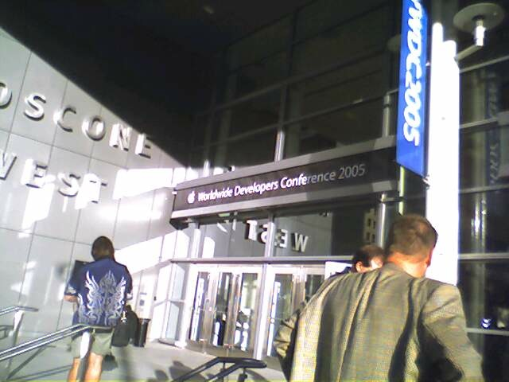
April 27, 2005 (Intel Transition)

Slide 12
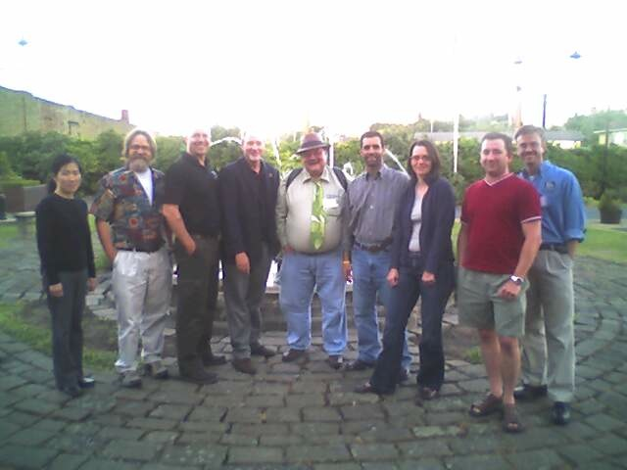
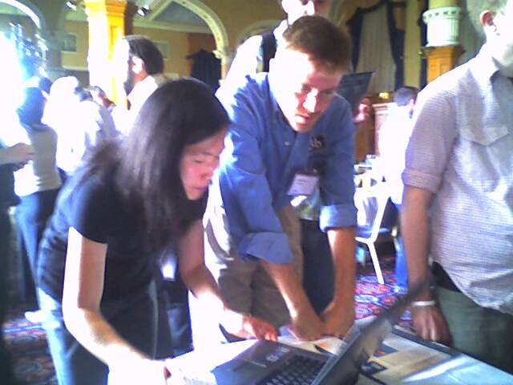
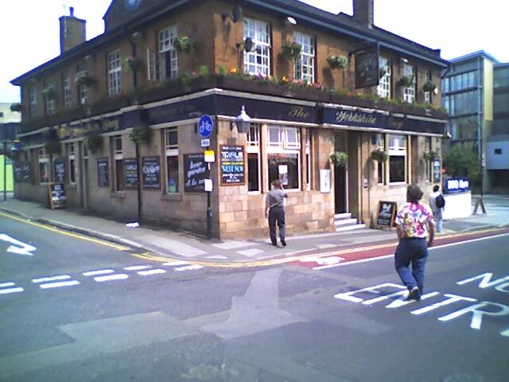
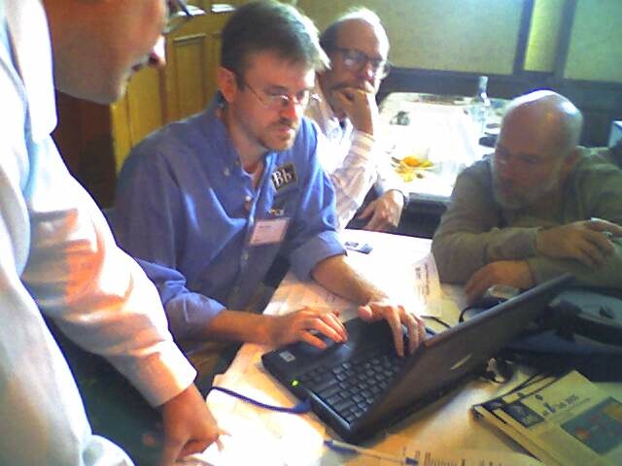
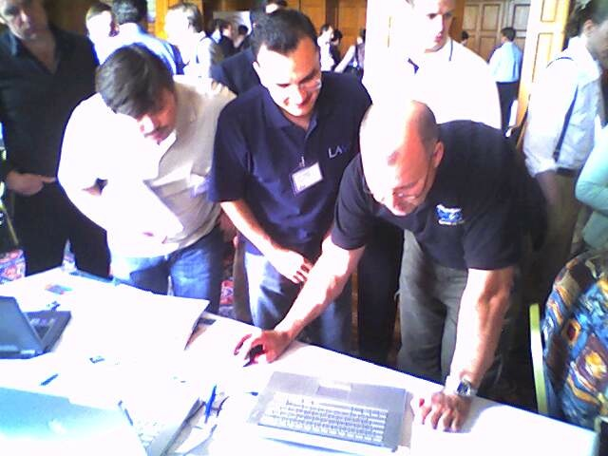
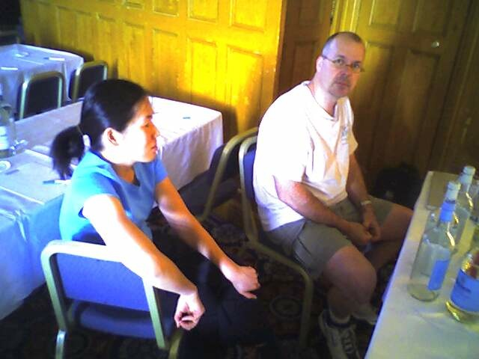
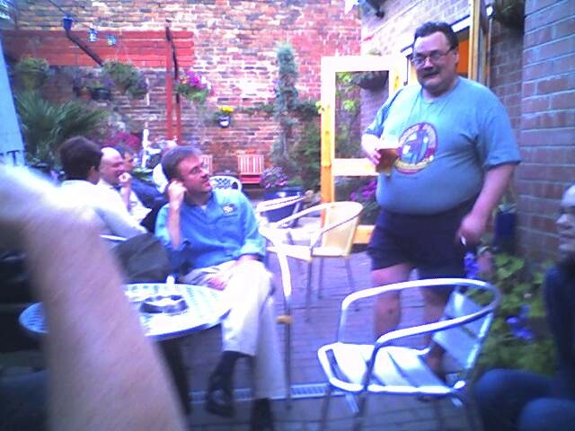
June 2005 – Tools Interoperability Demo

Slide 13
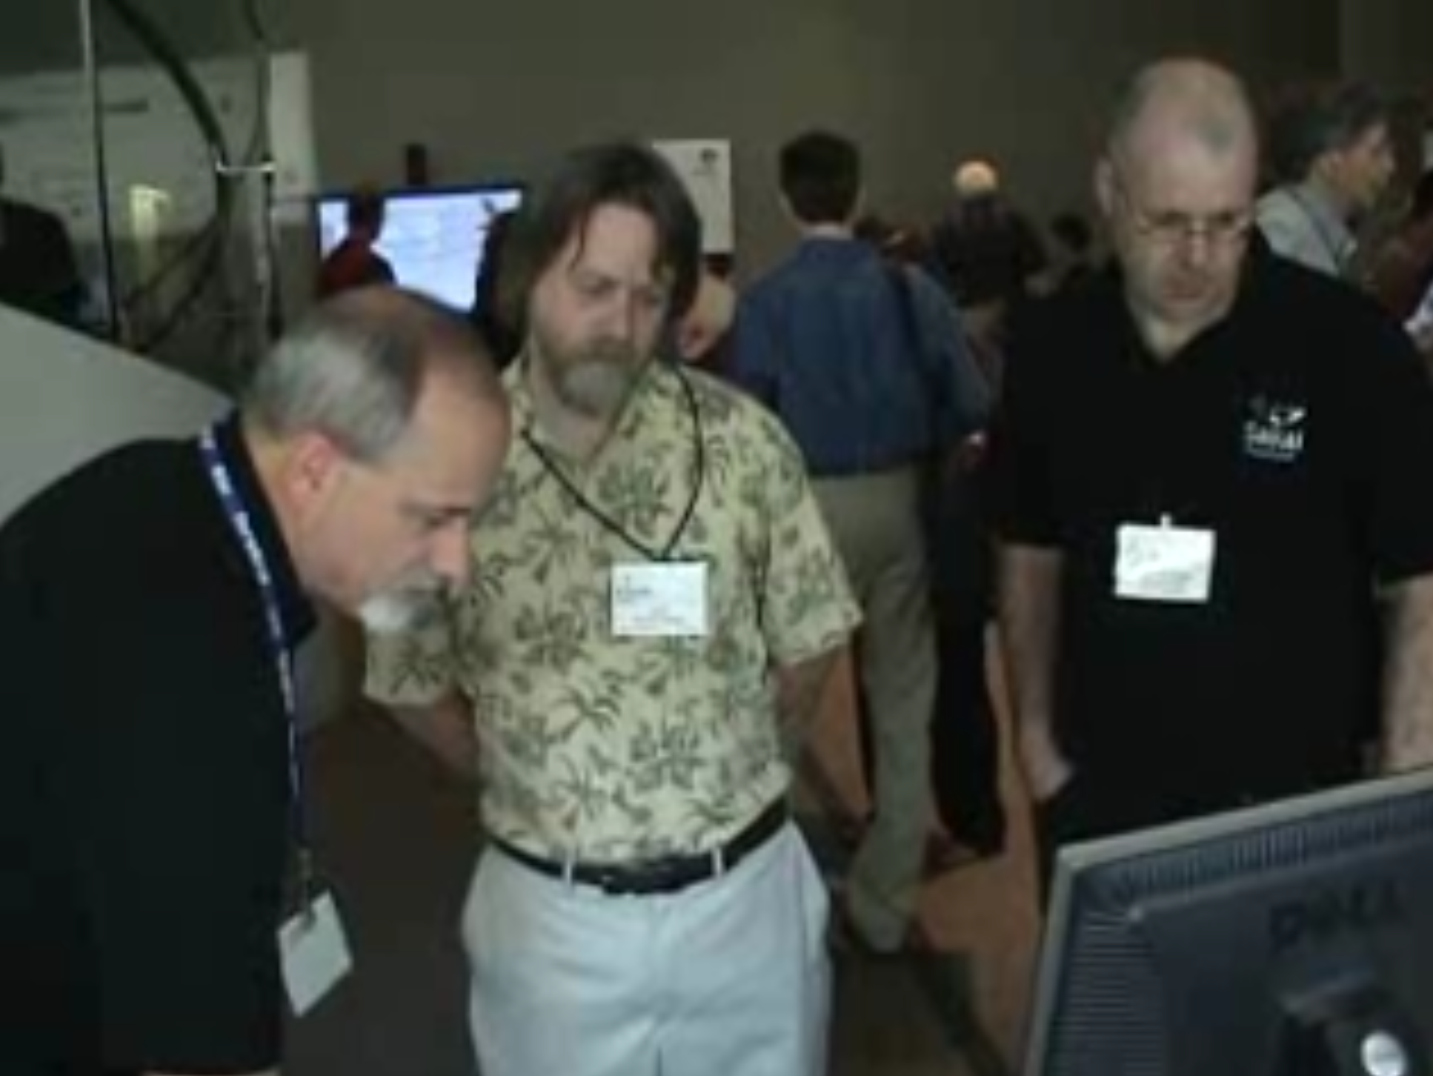
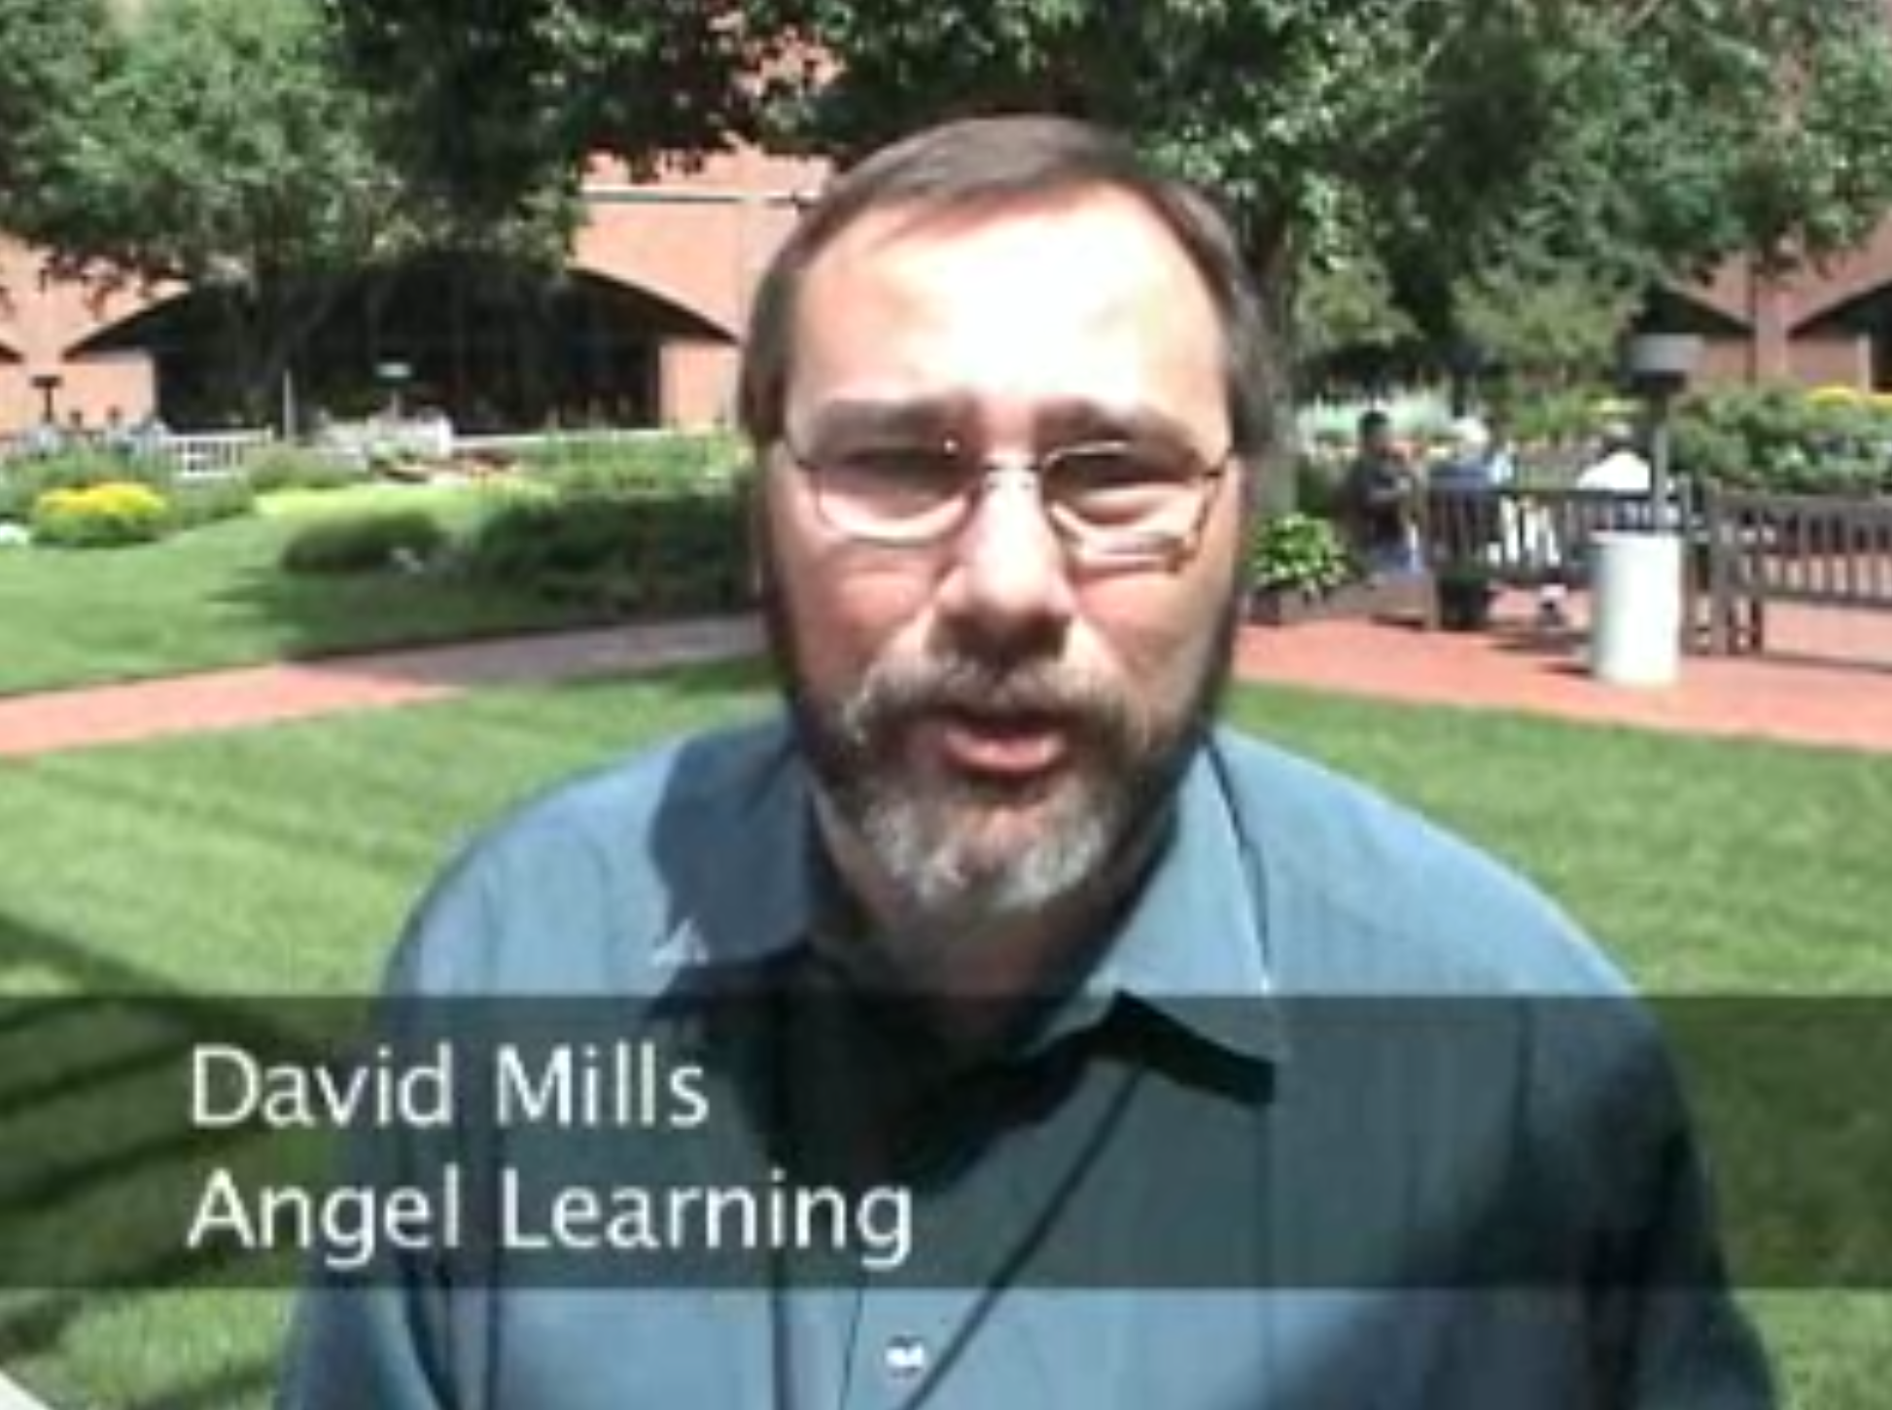
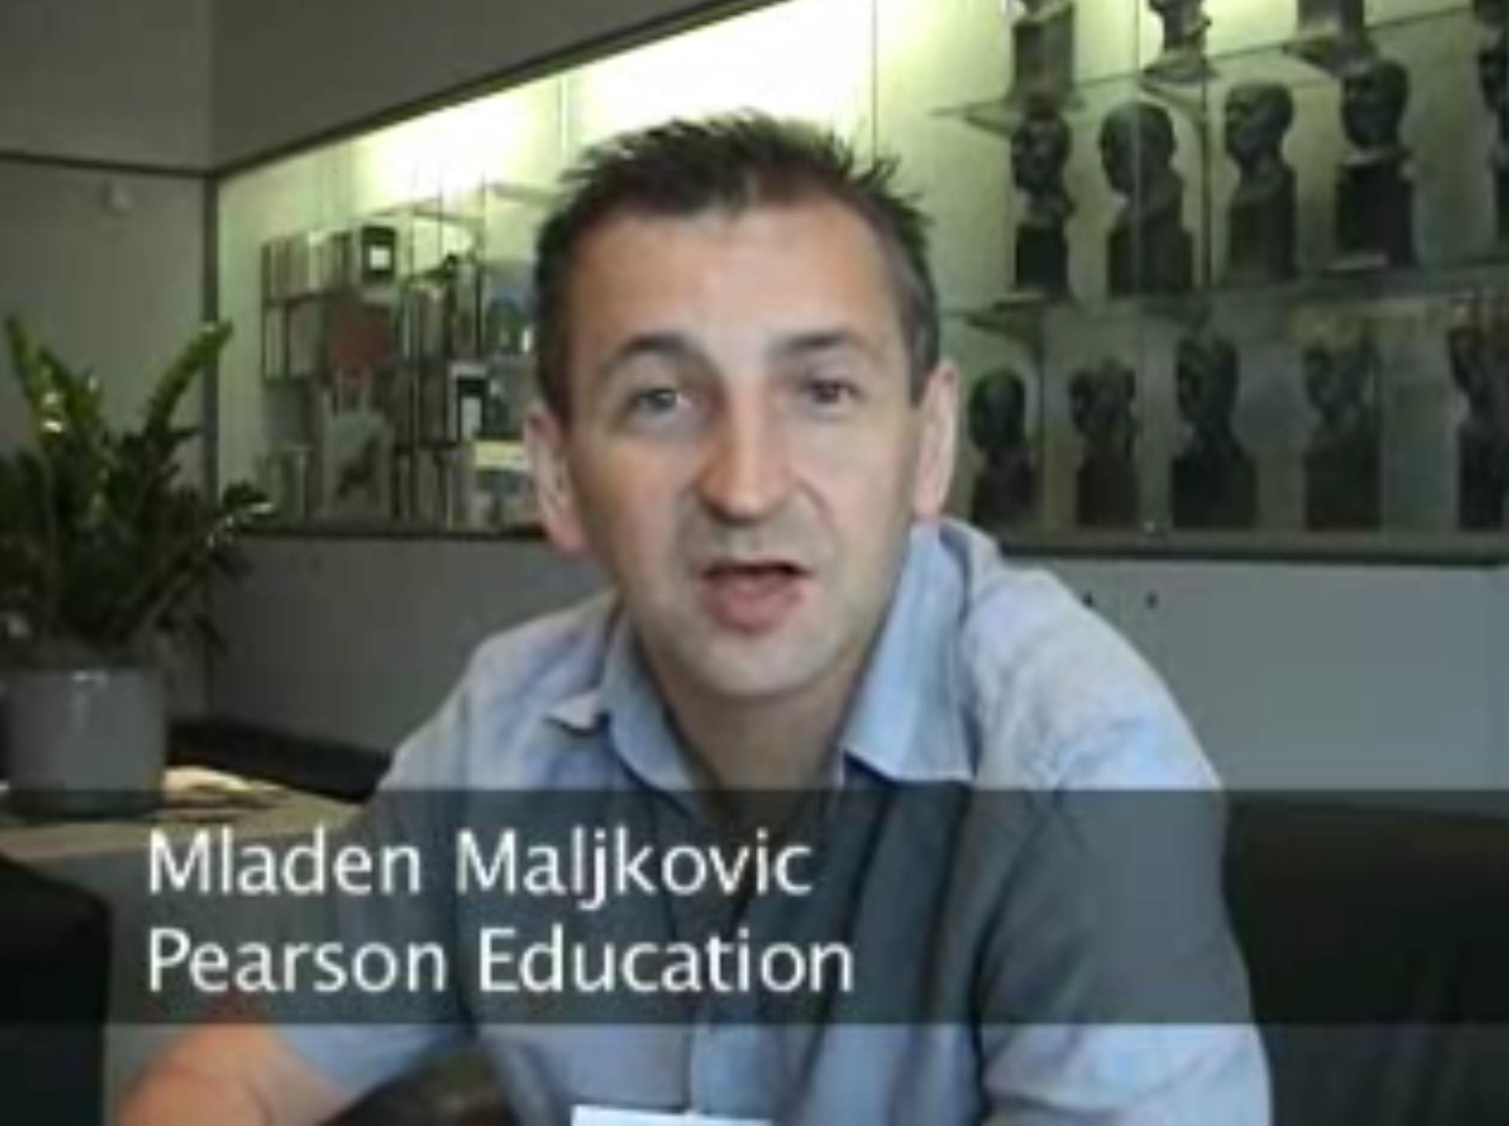
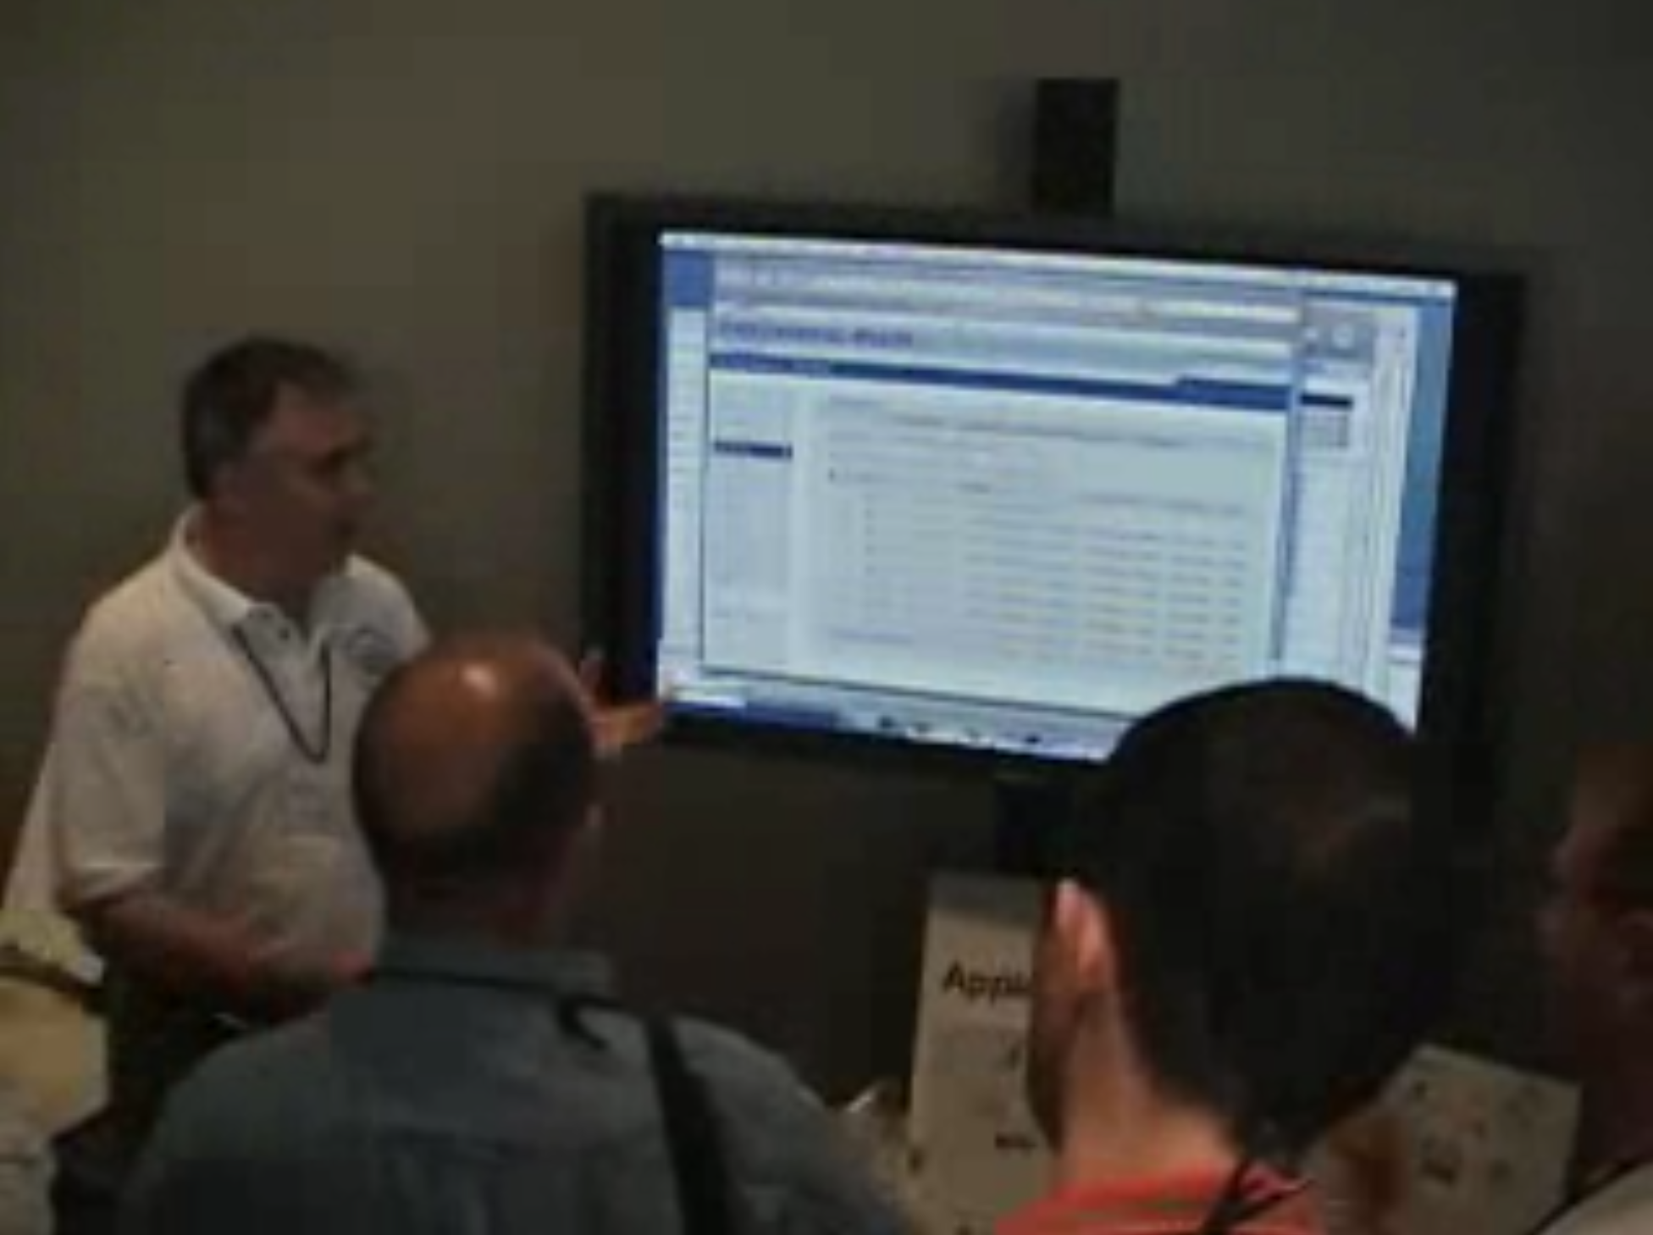
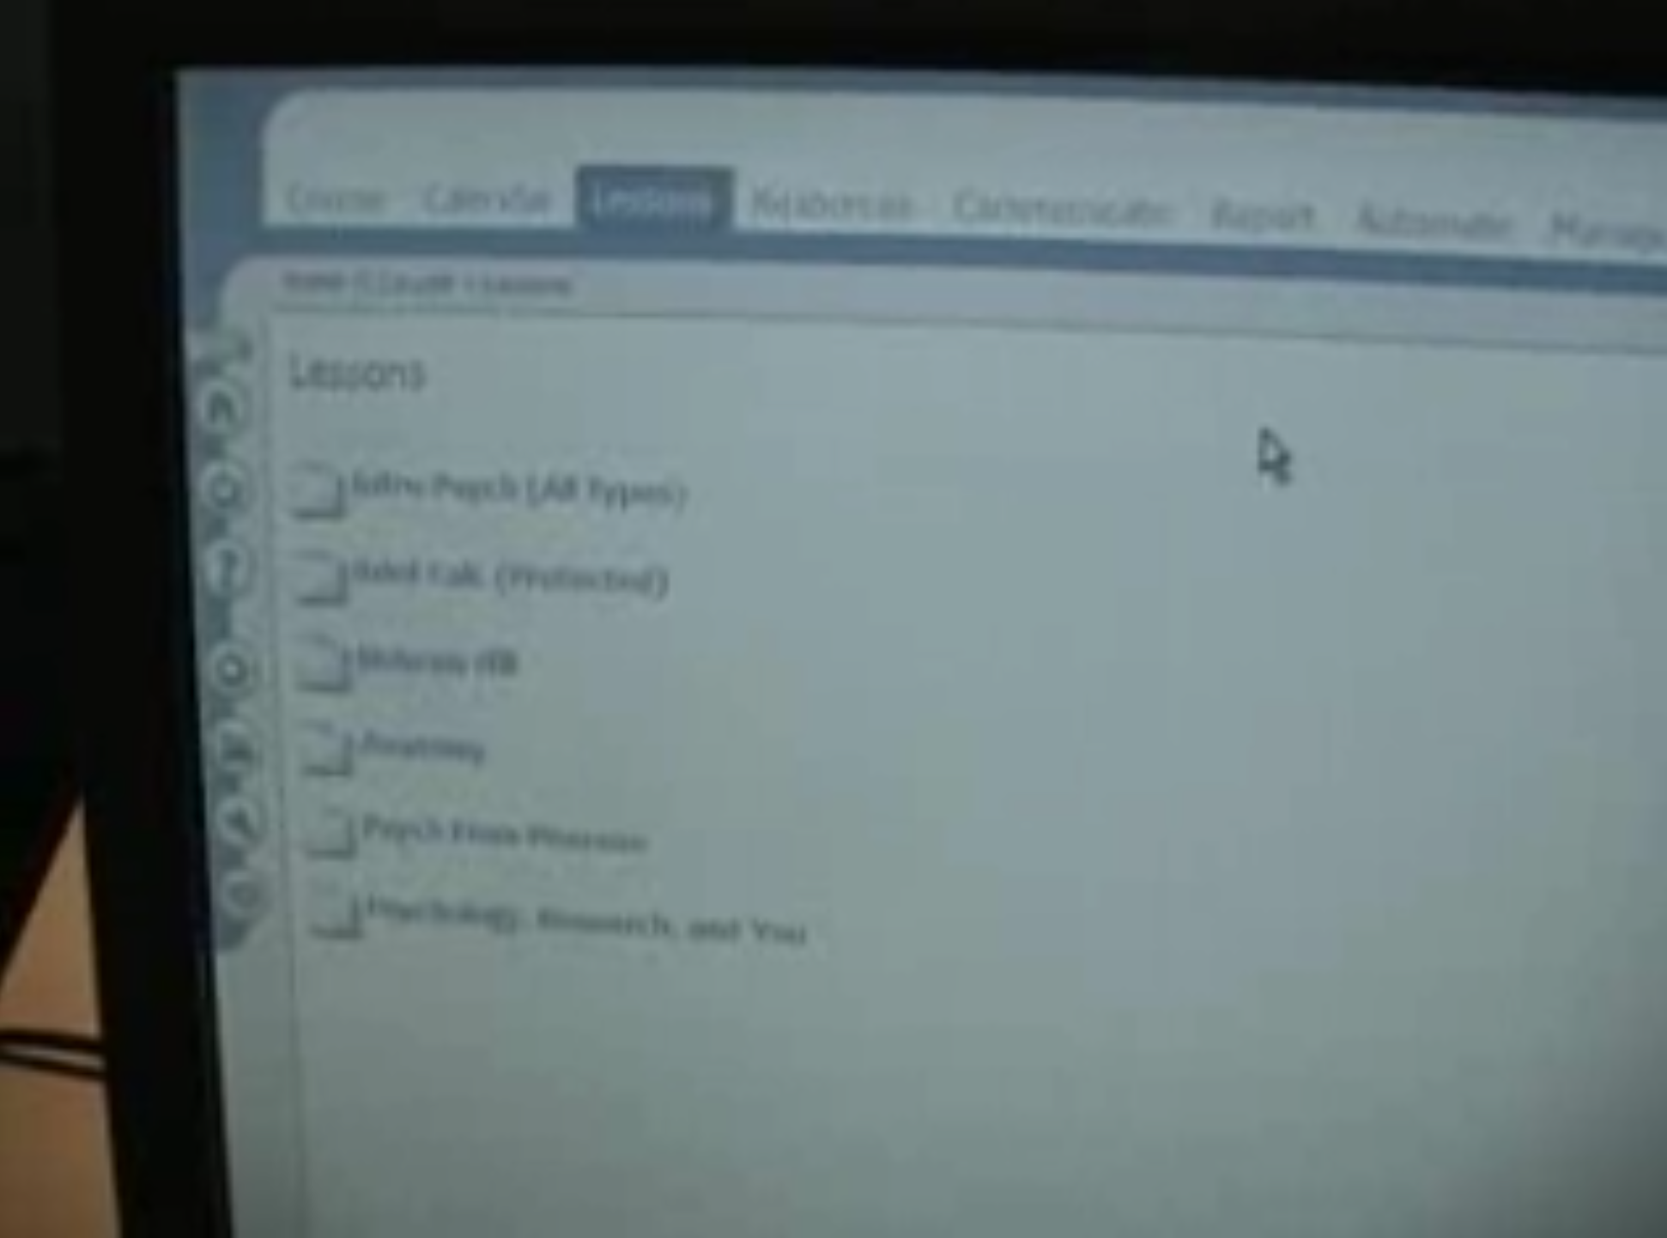
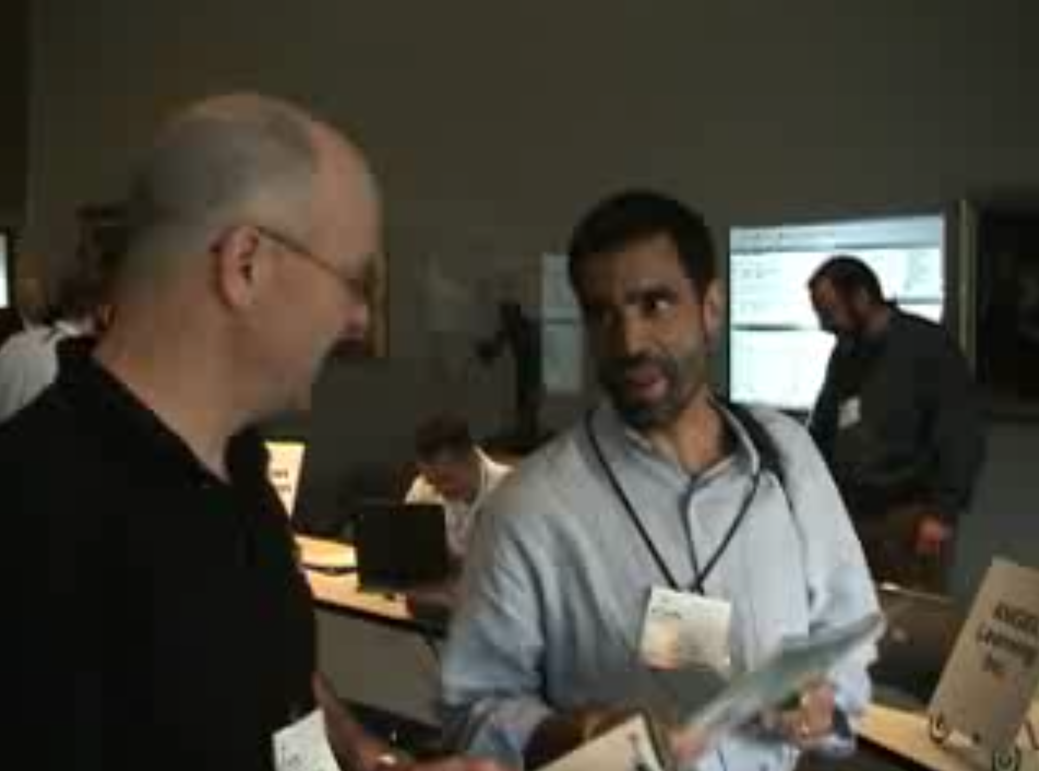
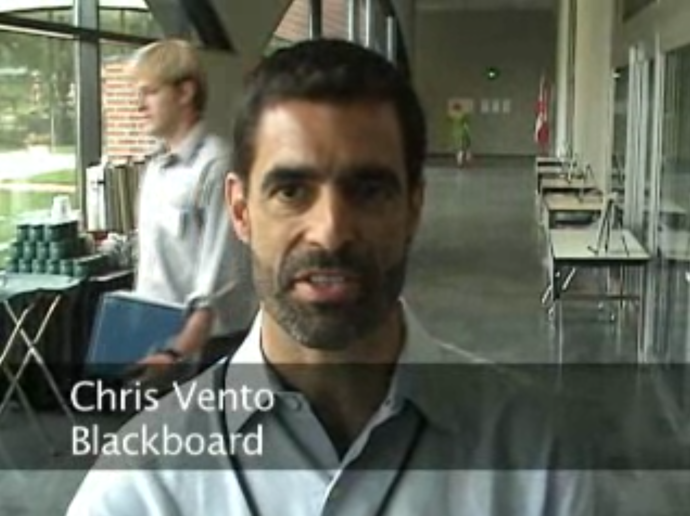
June 2006 – Common Cartridge Demonstration

Slide 14
At the End of 2006
200 Schools and growing
Over $1 million in the bank
Tools Interoperability In Progress
Common Cartridge In Progress
Sakai 2.2 and 2.3 were released
Things are pretty awesome – we are a juggernaught

Slide 15
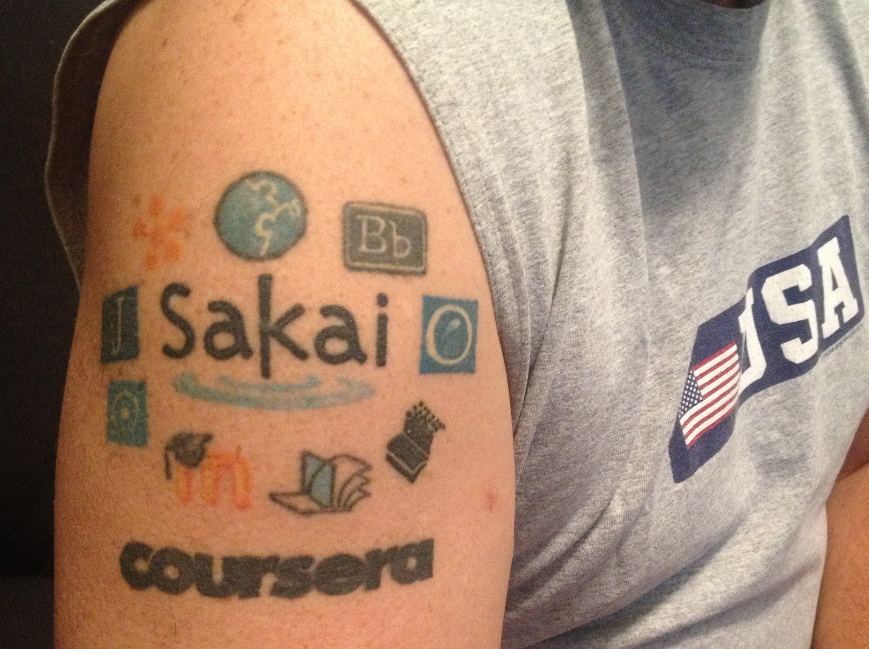
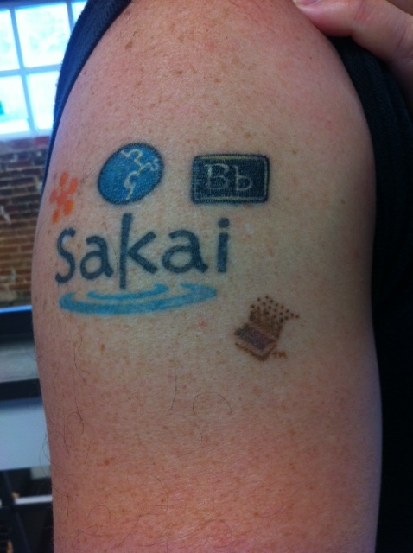
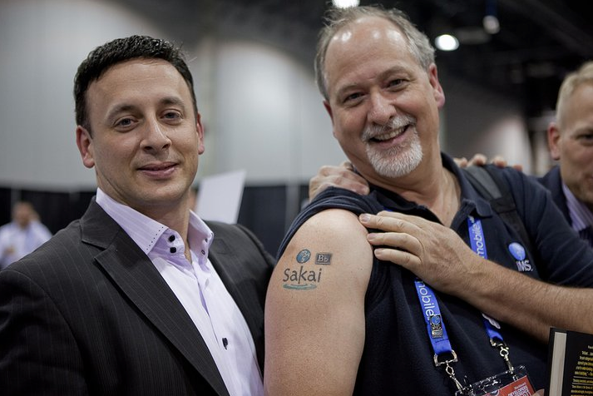
In three short years, Sakai's selfless innovation, focus on interoperability, and leadership changed the LMS market forever

Slide 16
Goal in 2008: Rewrite Sakai (*)
In 2008, Java seemed like it was fading away and would be replaced by cool new emerging technologies
Ruby on Rails (new language and web framework)
NoSQL and the end of Relational Databases
Backbone (JavaScript framework)
Angular (Another JavaScript framework)
A rewrite would be easy ---- right?
* Dr. Chuck was opposed to this idea – it is why I became a professor in 2007

Slide 17
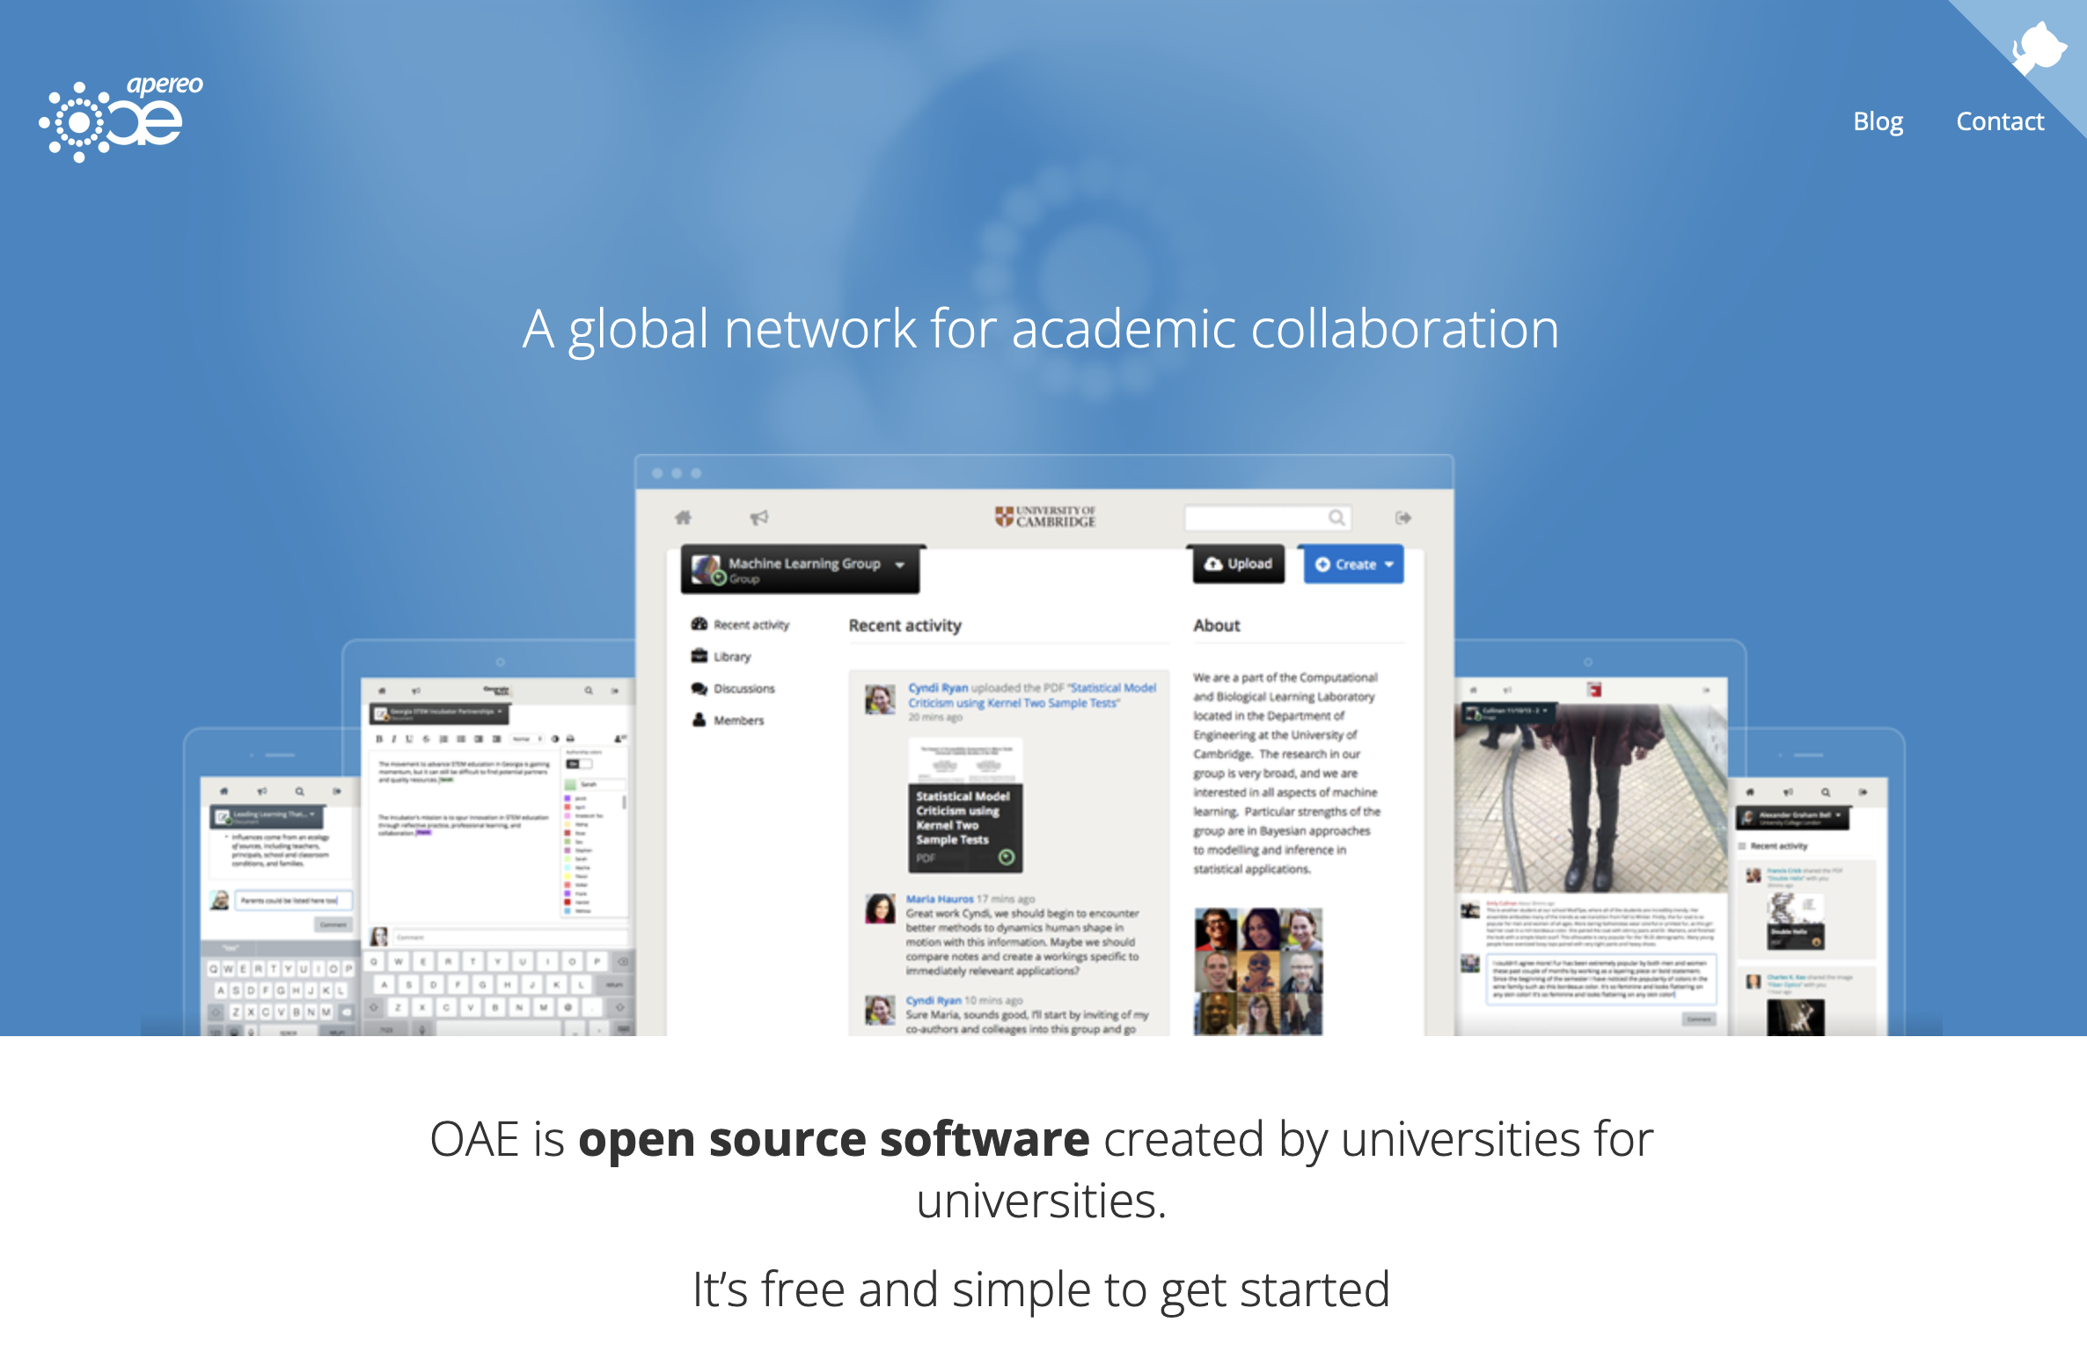
Sakai 3 / Open Academic Environment
The first Sakai rewrite started in 2008, confidence was very high and was scheduled to be 100% complete by 2009
It did not go well and had to be restarted with even newer technologies and new teams
2009, 2010, 2011, and 2012
A *lot* of university money was spent

Slide 18
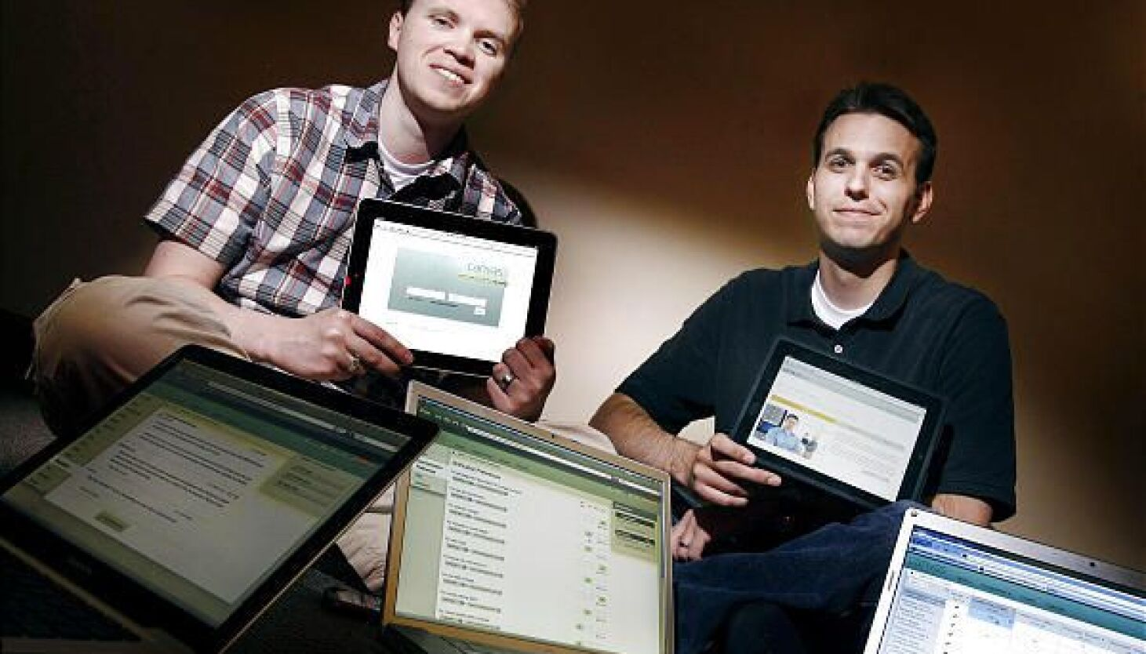
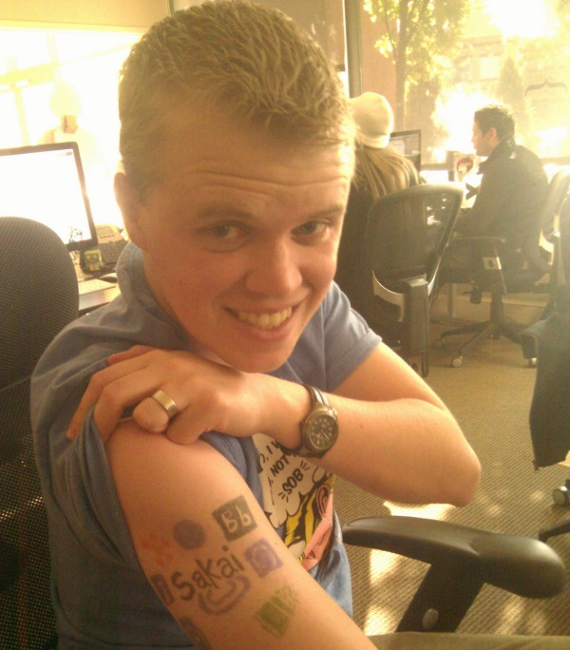
Meanwhile in Utah in 2008
Two BYU grad students looked at Sakai, its rewrite project, and reduced investment in the Java version of Sakai and thought, "Lets do the rewrite in Ruby on Rails!"
A rewrite would be easy ---- right?
Sakai OAE had broad dreams
Canvas greatly reduced functionality

Slide 19
Canvas was a Successful Rewrite of Sakai
Between 2002 and 2008, JavaScript changed everything
Sakai maintained a JavaScript-not-required UI until mid-2004
jQuery was released in 2006 and widely used
Between 2002 and 2008, Web services changed completely
Sakai used SOAP in 2004 – It was best practice back then ☺
Canvas started with REST (well supported in Ruby on Rails in 2008)
Standards changed a lot between 2002 and 2008
Sakai invented the standards and promoted them
Canvas implemented LTI and Common Cartridge better than any other LMS

Slide 20
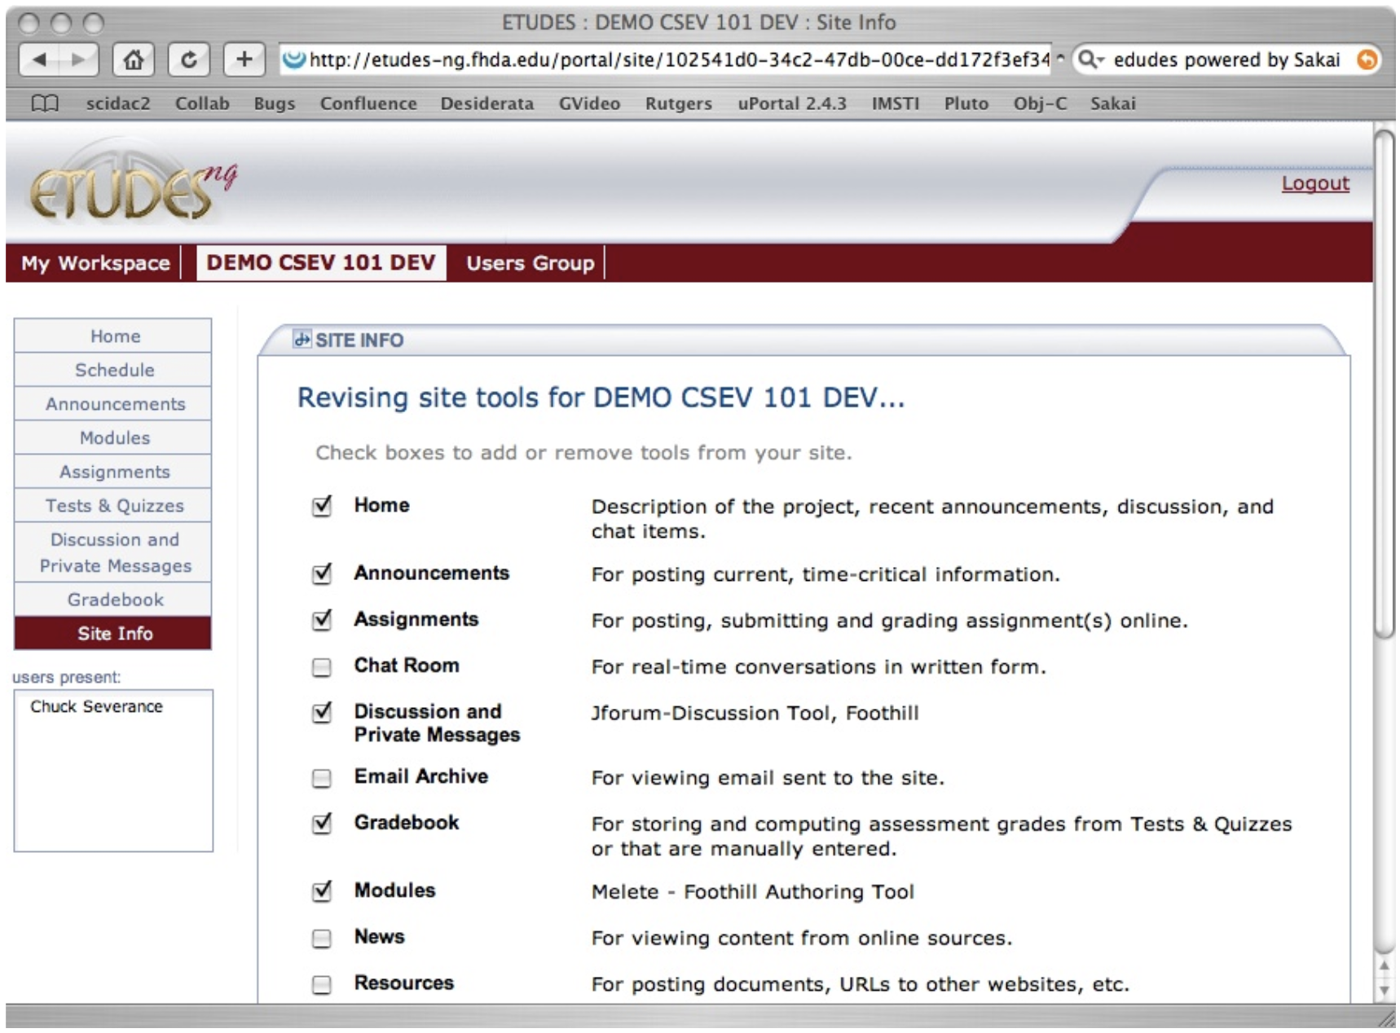
The architecture, UI, and interaction design of Canvas came from studying Sakai in 2007 and simplifying it.
Canvas was a Successful Rewrite of Sakai

Slide 21
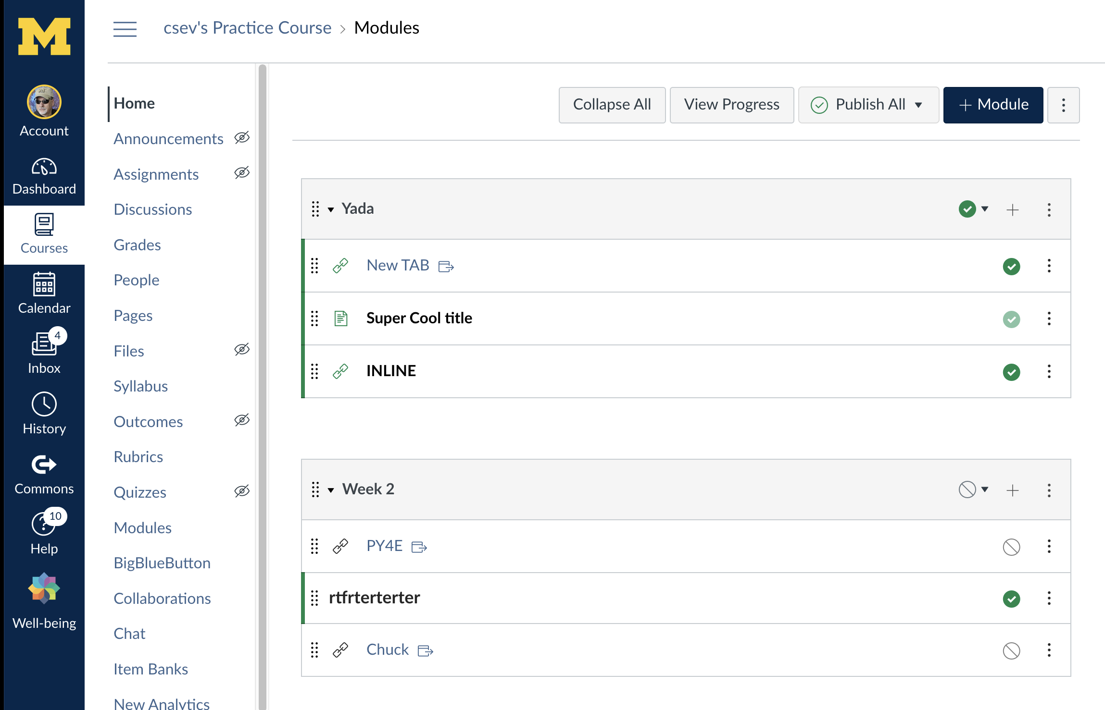

Slide 23
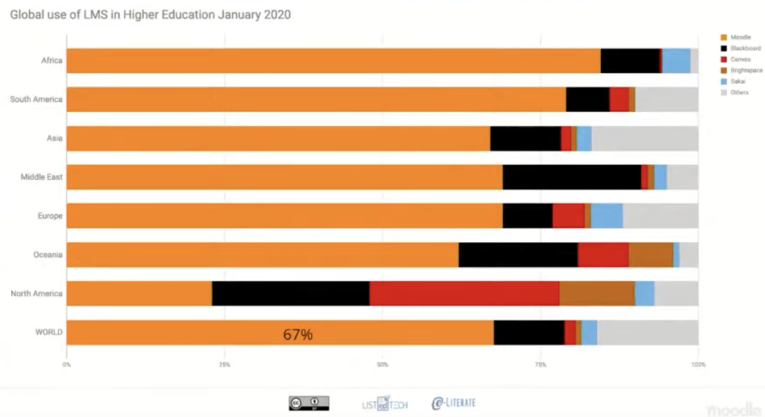
Canvas is #1 where Moodle is not #1

Slide 24
Refocusing on the Sakai Java code base
Between 2008 and 2018, many things changed
Ruby on Rails was no longer cool
Endless revolutionary ideas were cool for a year or two then faded
NoSQL, Backbone, Angular, Scala ..
Java had major investment and became one of the most viable and widely used web frameworks
Annotations, Spring, Java Persistence Architecture, Thymeleaf …
It took some time, but Web Components are part of the browser
Sakai just stayed with its Java code base and made it better

Slide 25
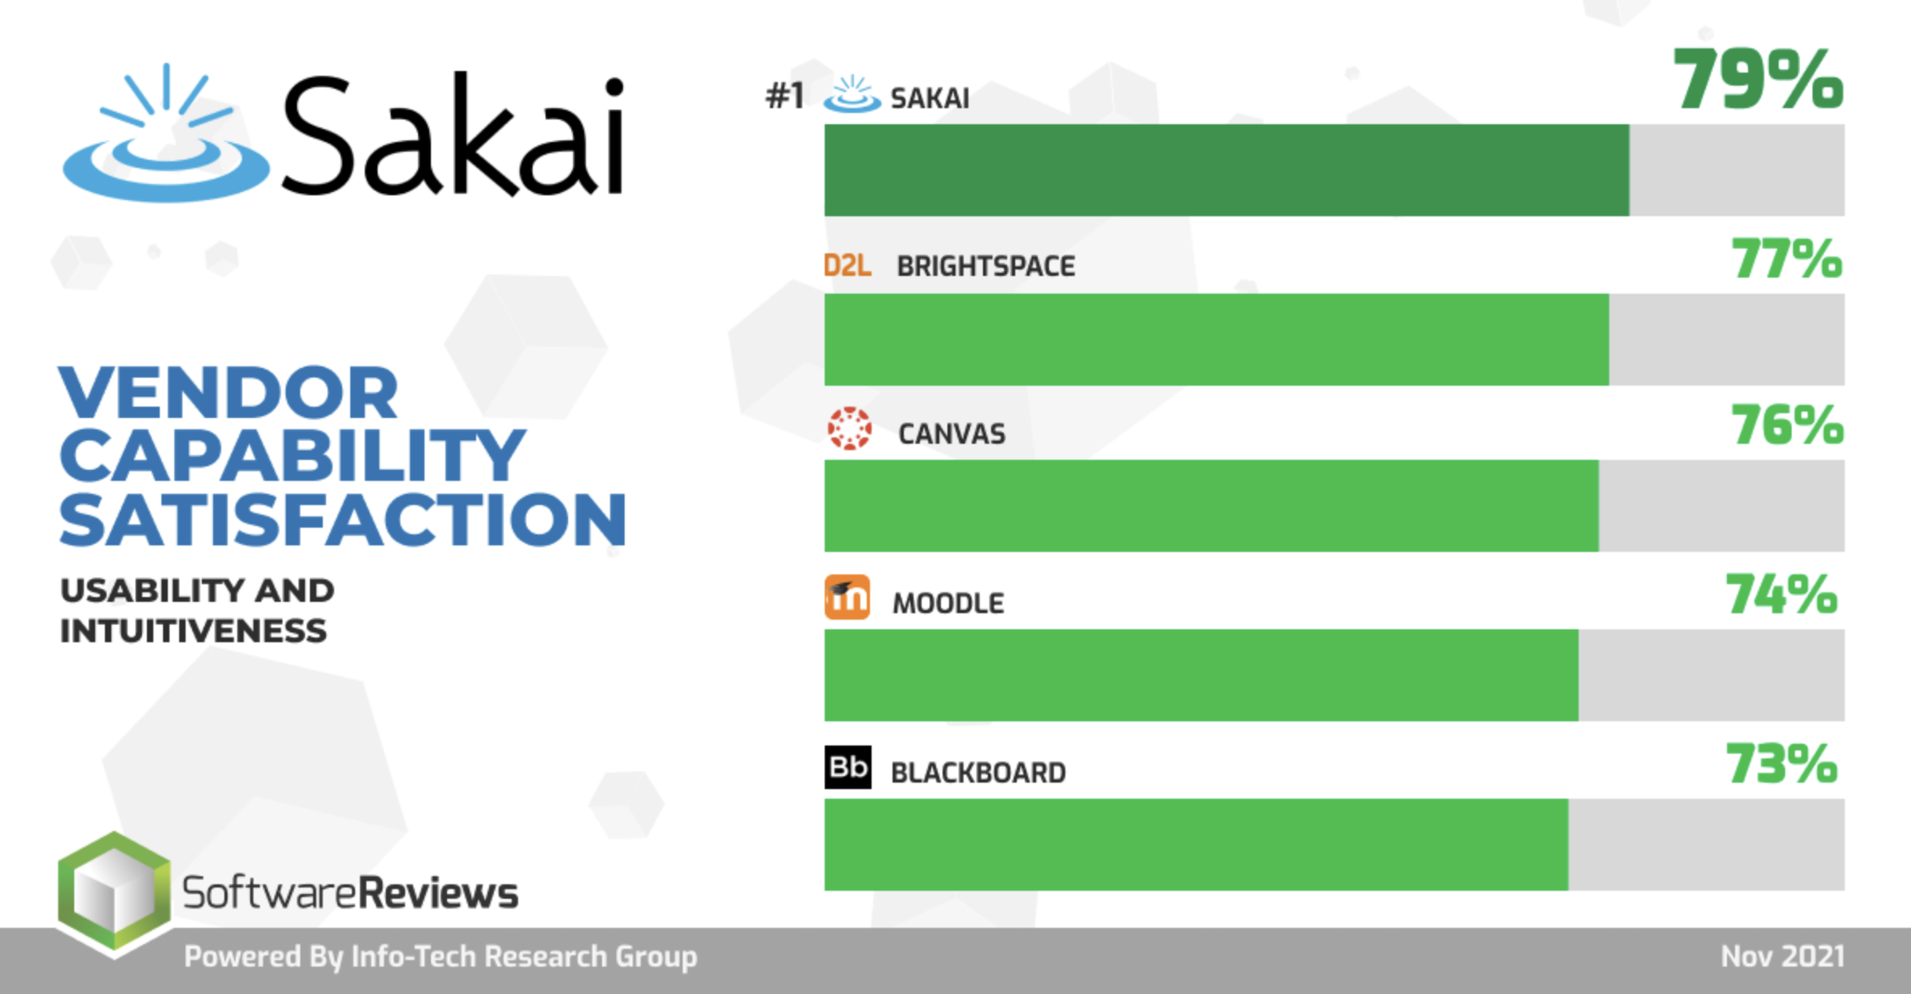

Slide 26
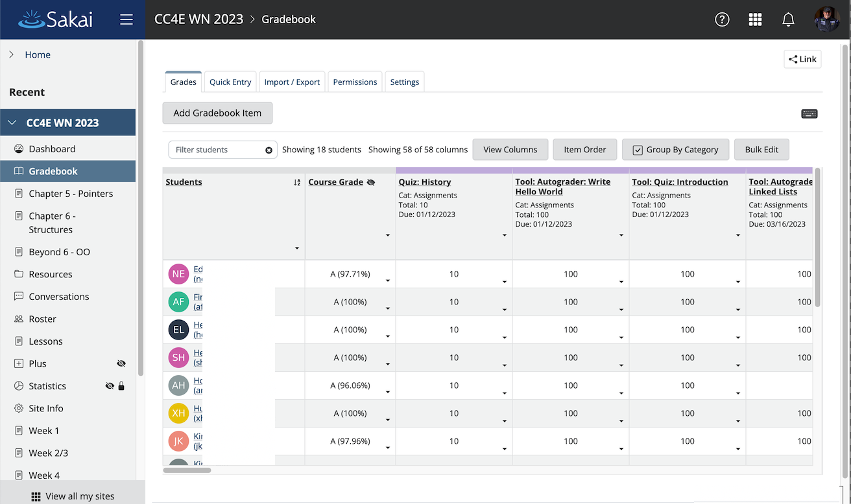

Slide 27
Sakai Leadership Going Forward

Slide 28
If you had to guess which LMS would build a tool to improve the user experience of other LMS's what it be?
Blackboard
Desire2Learn
Moodle
Canvas
Sakai

Slide 29
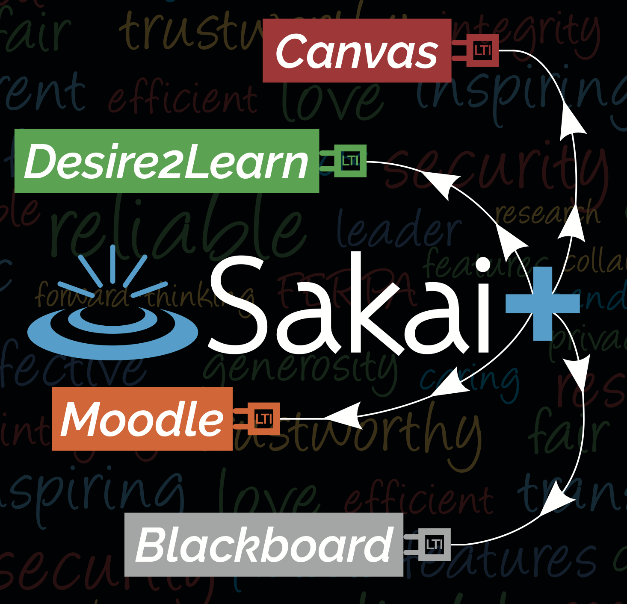
SakaiPlus – LMS Multiverse
Part of Sakai 23
Sakai can plug into any LMS using LTI Advantage (1.3)
Multi-tenant hosting keeps costs of small instances low
Part of the sustainability plan for Sakai commercial providers

Slide 30
SakaiPlus – A different way to rewrite
????

Slide 31
If you were to build an LMS in 2024…
Standards would be at the core
The overall architecture / decomposition
The "internal design documents"
The web services
There would be a complete separation between UI/UX on the front end and service implementations on the back end
Progressive Web Application
Augmented Reality
Video Game Console
Television Application

Slide 32
What is an LMS?
Course Authoring – Common Cartridge
Enrollment Management - OneRoster
Course Management Runtime – LTI Advantage
Tool Orchestration – LTI
Roster Orchestration – Names and Roles
Grade Book – Outcomes
Course Tracking – Caliper / XAPI
Other things like Rubrics / Competencies and Academic Standards

Slide 33
What if…
We had a team of 10 developers deeply connected to a community of teachers , instructional designers, and students
Experts in developing a production / scalable LMS
Experience in choosing new tech stacks and then living with that choice years later
Experienced in the complexity required in a new LMS
Able to continuously bring new ideas from the rewrite back to the legacy LMS and put them into production with real users
And we gave them 3-5 years
We learn from the mistakes of WebCT Vista, Sakai 3.0, Blackboard Learn, Blackboard Ultra and emulate the success of Canvas

Slide 34
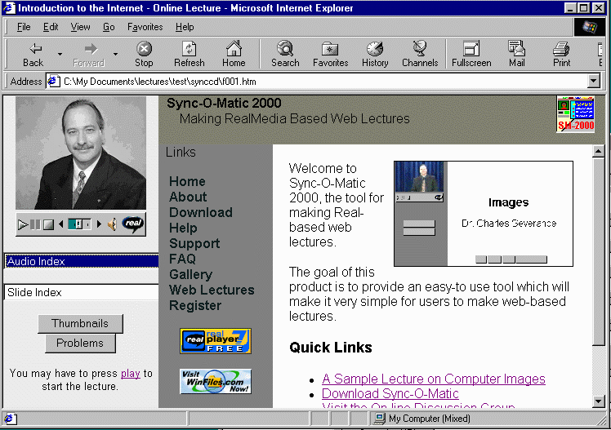
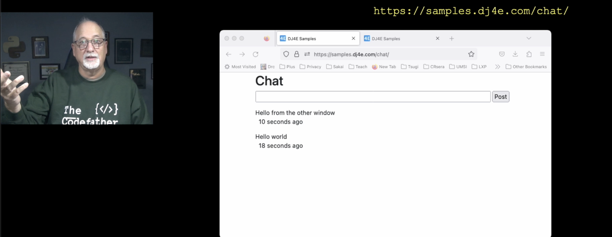
As a Teacher…
I use many LMS's
Canvas
Sakai
Tsugi
Coursera
edX

Slide 35
As a Teacher…
I use many LMS's
Canvas
Sakai
Tsugi
Coursera
edX
I don't like any of them particularly well (5/10)

Slide 36
As a Teacher…
I use many LMS's
Canvas
Sakai
Tsugi
Coursera
edX
I don't like any of them particularly well (5/10)
But the superset of the ideas *across* all these systems in a smooth, well integrated set of components would change my teaching forever

Slide 37

We are at a unique moment in time…

Slide 38
We are at a unique moment in time… Just like we were 20 years ago.

